Slide 1
FOG/HAZE REMOVAL (from single image and real-time video)
Submitted by :- Soumam Banerjee
Notes:
1

Slide 2
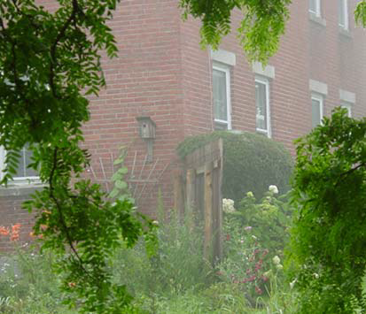
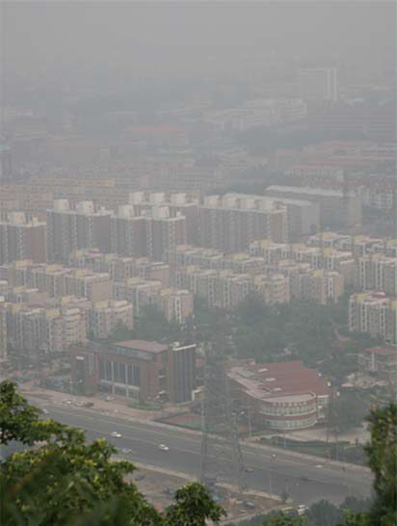
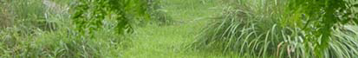
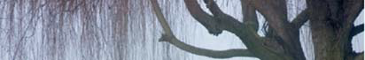
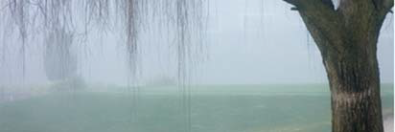
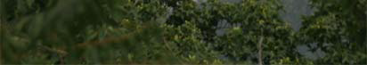
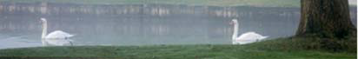
Notes:
1

Slide 3
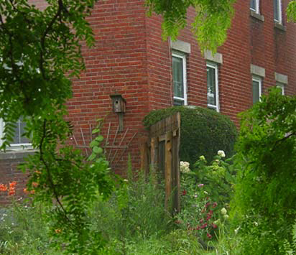
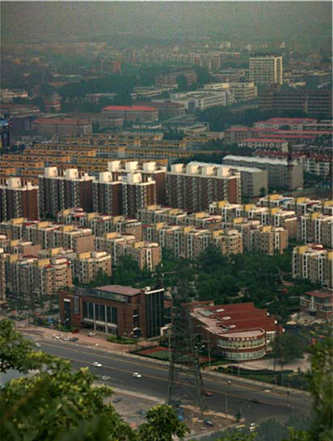
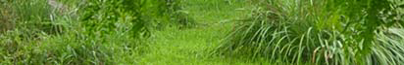
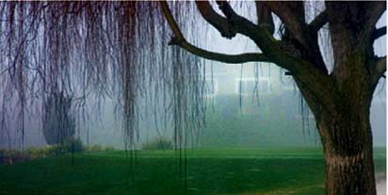
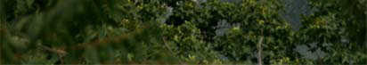
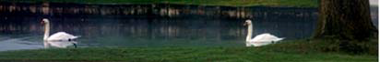
Notes:
1

Slide 4
The Problem
Fog, Haze, or Smog
Want a clear image
Weather could be common in areas
Notes:
1

Slide 5
The Method
Outlined in paper:
Single Haze Removal Using Dark Channel Prior
by Kaimin He, Jian Sun, and Xiaoou Tang
Notes:
1

Slide 6
What is haze?
I(x) = J(x)t(x) + A(1 − t(x))
I(x): Image
J(x): Scene Radiance
A: Atmospheric Light
t(x): Transmittance
Notes:
1

Slide 7
Dark Channel Prior
Objects of interest have low values in at least one color channel
Green leaf
Car Shadow
Dark building
Haze has a high pixel intensity
Notes:
1

Slide 8
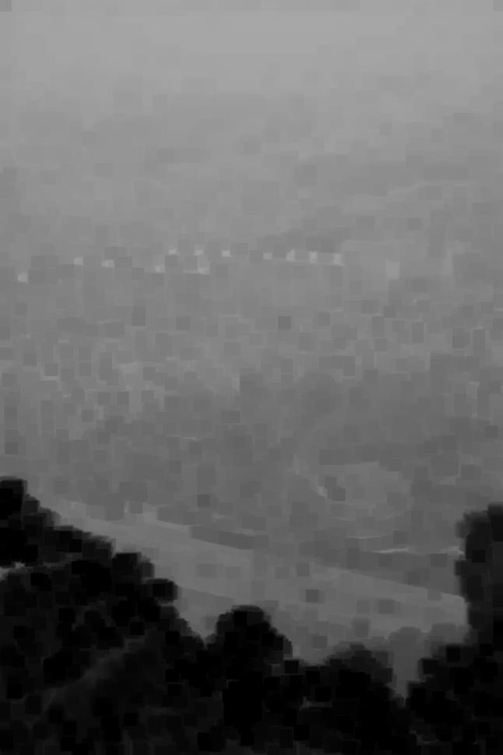
INPUT IMAGE
DARK CHANNEL
Notes:
1

Slide 9
Compute Atmospheric Light
I(x) = J(x)t(x) + A(1 − t(x))
High values in Dark Channel
Take top 0.1%
Pull Values from original image
Average
Notes:
1

Slide 10
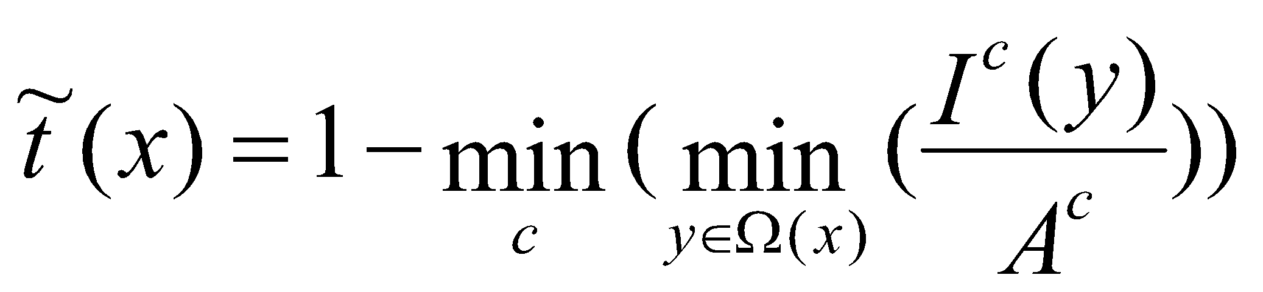
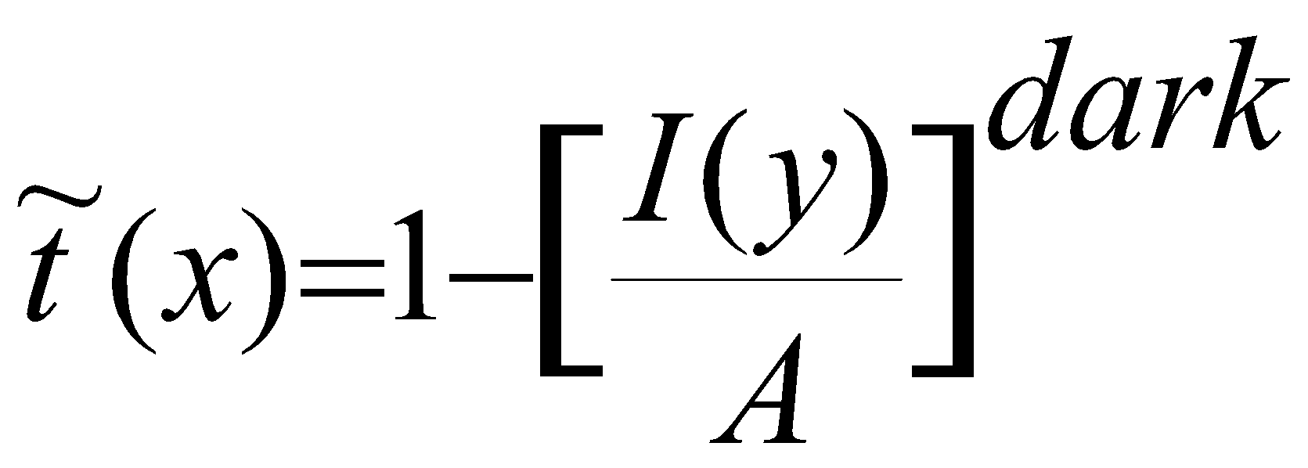
Estimating Transmission
Shuffling the Haze Equation and taking min’s gives you:
Which is simply:
Notes:
1

Slide 11
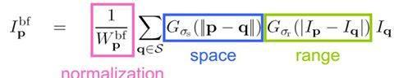
Bilateral Filter
The bilateral filter is defined as:
A bilateral filter is a non-linear, edge-preserving, and noise-reducing smoothing filter for images. It replaces the intensity of each pixel with a weighted average of intensity values from nearby pixels.
Notes:
1

Slide 12
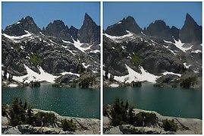
Refine Transmission with bilateral filter
Estimated Transmission is blocky
Want to take into account fine detail
Notes:
1

Slide 13
Things to improve
Performance
Processing Time
(at present its 0.4 secs for hd image of height---> 1235 and width----> 2572
0.08 secs for an image with dimensions 600x400 )
Memory Allocation
A GUI based implementation of the software in PyQt/Tkinter
Notes:
1

Slide 14
Things To Expand
Depth Map
From Transmittance
3D Model
Image Enhancement
Histogram Equalization
Notes:
1

Slide 15
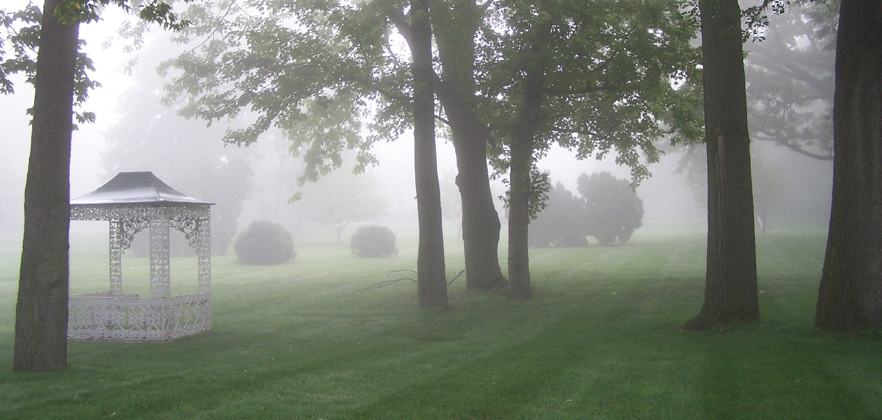
Current Results
Input foggy/hazy image
Notes:
1

Slide 16
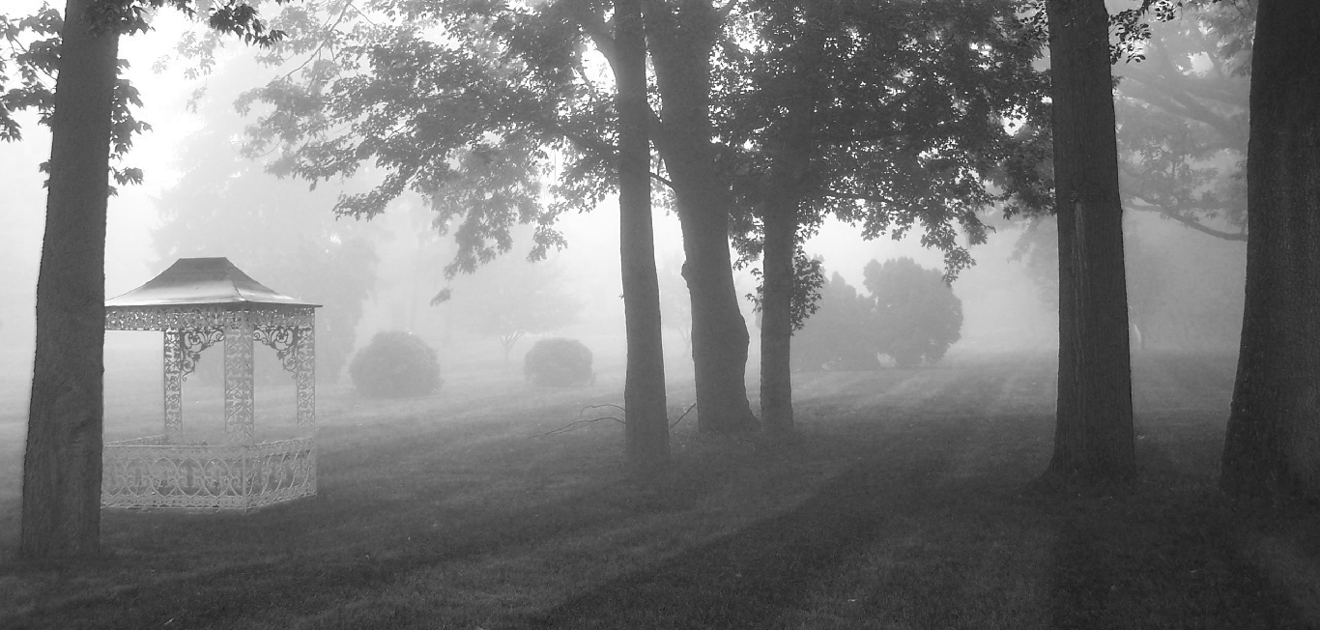
Dark Channel ( without using 𝞨 channel [using it would make it more accurate but computationally a bit expensive])
Notes:
1

Slide 17
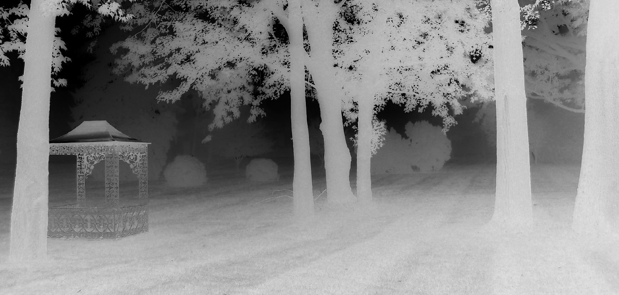
Transmission Map
Notes:
1

Slide 18
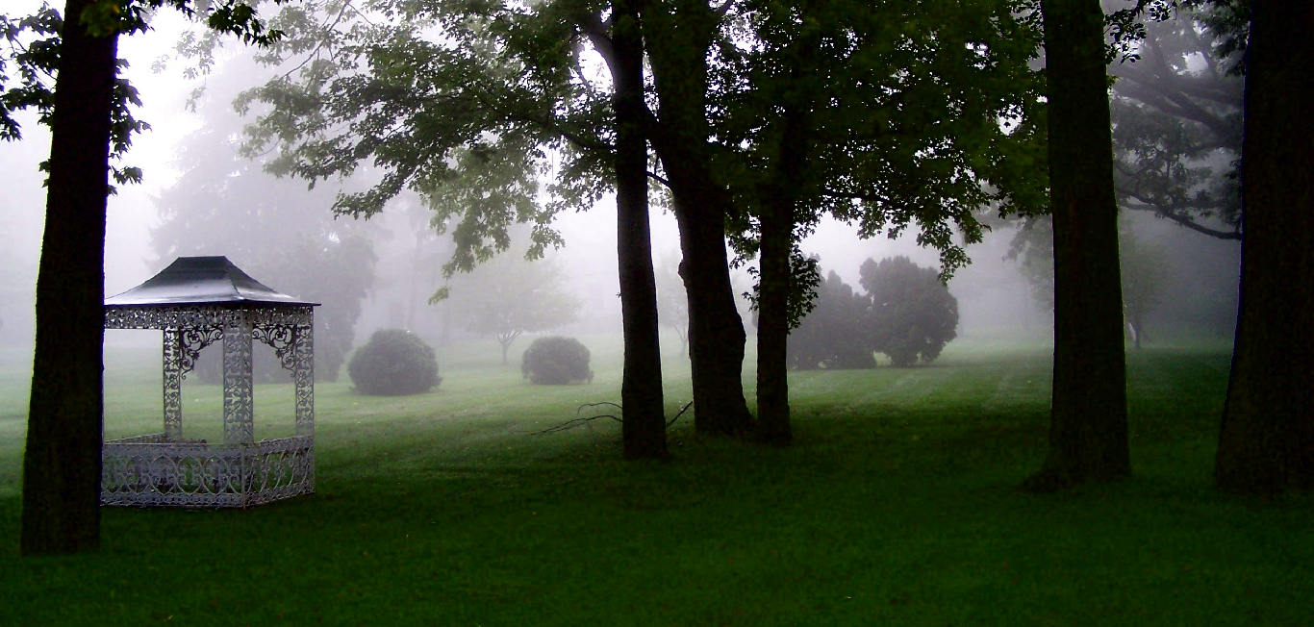
INPUT IMAGE
OUTPUT IMAGE
Notes:
<number>

Slide 19
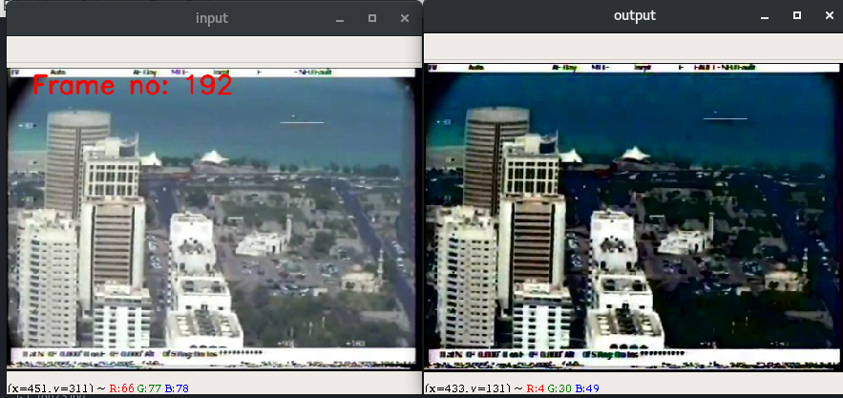
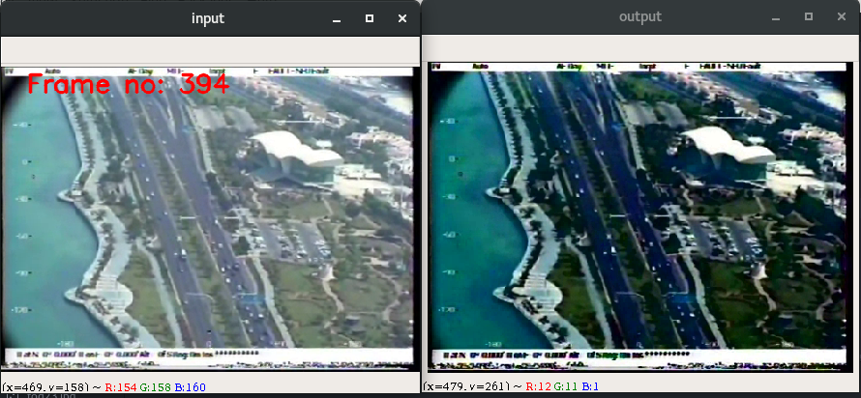
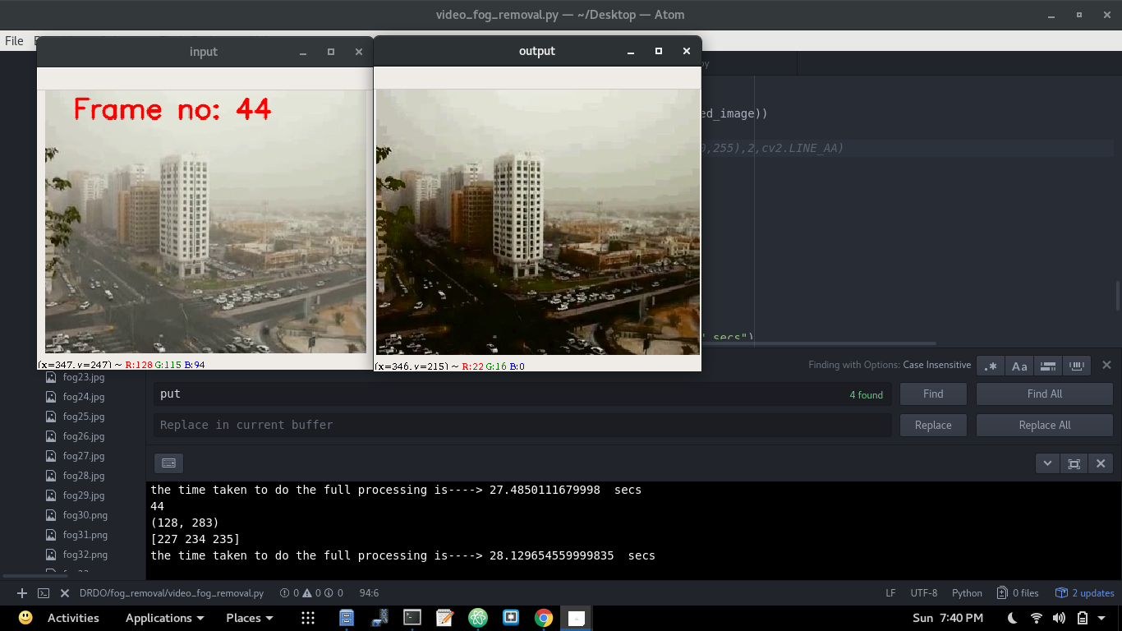
Video Results
Input and output of ‘fog_video_1.mp4’ (Frame no:- 192)
Input and output of ‘fog_video_1.mp4’ (Frame no:- 394)
Input and output of ‘fog_video_2.mp4’ (Frame no:- 44)
Notes:
<number>

Slide 20
Notes:
<number>

Slide 21
Thank You
Notes:
<number>

